Slide 1
A Case Study in Talent Management
by Justin Ehly

Slide 2

Analysis Overview
Attrition
Job Role Trends
Monthly Salary Estimation

Slide 3







Methodology
Boruta Algorithm
Wrapper Built Around Random Forest Classification Algorithm
Top-down Search for Relevant Veatures
Compares Original Attributes’ Importance to Importance Achievable at Random
Estimates Using Permuted Copies
Progressively Eliminates Irrelevant Variables
~ 18 Variables determined to be Significant or Possibly Significant

Slide 4
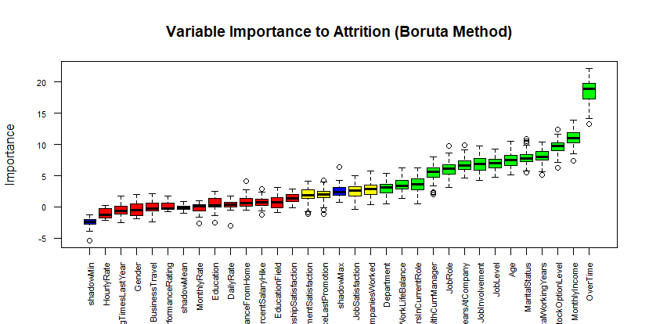
Attrition Variable Importance (Using Boruta)

Slide 5
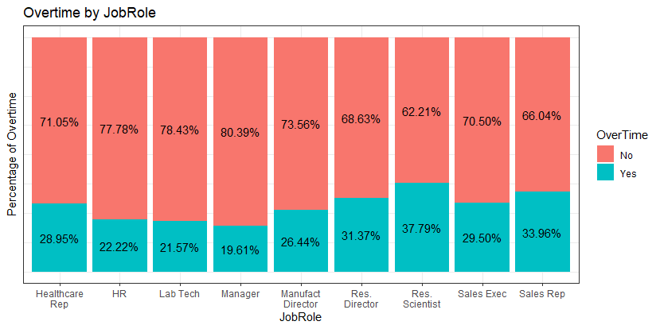
Overtime
29% Employees Earn Overtime
71% Employees Don’t Earn Overtime
*No Data on Bonuses
Very low p-value vs Attrition, appears to be statistically significant
Average Monthly Income
No OT: $6,464.41
Yes OT: $6,208.43
-$255.98 difference for OT Earners
*T-tests and Chi-Sq Tests in Appendix
JobRole | OT:Yes Monthly Income | OT:No Monthly Income | Diff
Sales Rep | $2,369.00 | $2,798.80 | $429.80
Res. Scientist | $3,342.86 | $3,208.59 | -$134.27
Lab Tech | $3,487.30 | $3,148.86 | -$338.44
HR | $3,581.33 | $3,199.86 | -$381.48
Sales Exec | $6,831.90 | $6,916.84 | $84.94
Healthcare Rep | $7,613.41 | $7,362.80 | -$250.61
Manufact Director | $7,876.61 | $7,371.75 | -$504.86
Res. Director | $15,632.31 | $15,803.66 | $171.34
Manager | $16,617.20 | $17,338.61 | $721.41

Slide 6
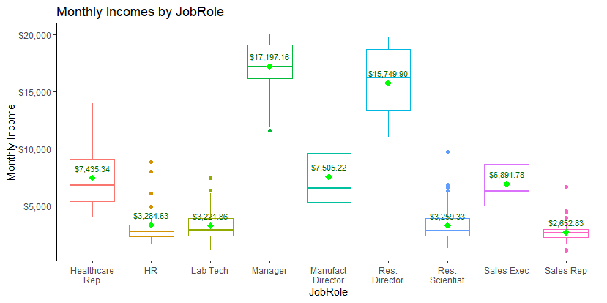
Monthly Income
Mean incomes populated in chart and marked with green diamond
p-value = 2.41e-07 shows statistical significance
Lowest independent p-value for all numerical variables
*T-tests and Chi-Sq Tests in Appendix

Slide 7
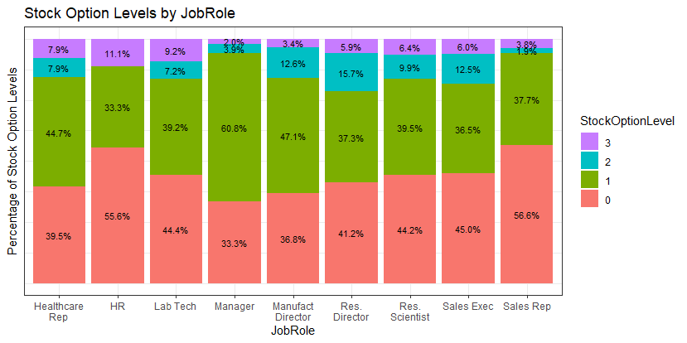
Stock Option Levels
43.6% Employees Do Not have Stock Options
40.8% = Level 1
9.3% = Level 2
6.3% = Level 3
p-value = 3.724e-12
2nd Lowest p-value of all categorical variables
*T-tests and Chi-Sq Tests in Appendix

Slide 8
The Top 3 Factors Affecting Attrition
OverTime p-value = 2.33e-15 (lowest independent p-value for all categorical variables)
MonthlyIncome p-value = 2.41e-07 (lowest independent p-value for all numerical variables)
StockOptionLevel p-value = 3.724e-12 (2nd lowest independent p-value for all categorical variables)

Slide 9
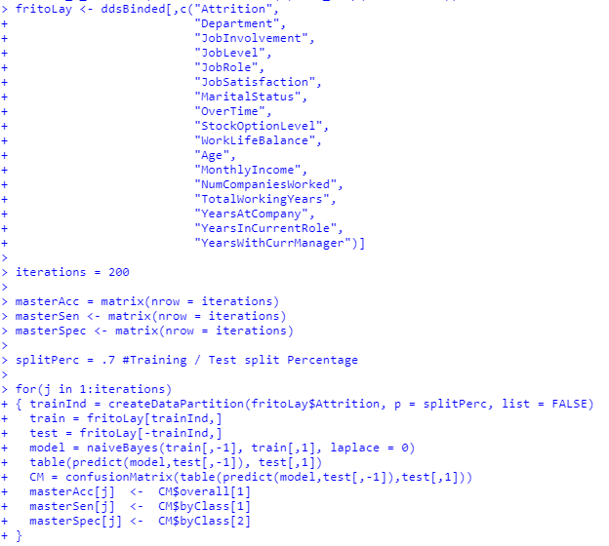
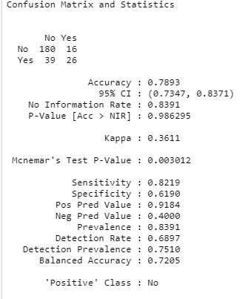
Attrition Model

Slide 10
Job Role Trends by Average Scores/ Values
Age (18-60 years)
47.5 – average oldest - Managers
30.5 – average youngest age – Sales Reps
Distance From Home (1-29 miles)
9.8 miles – farthest average - Healthcare Reps
7.9 miles – shortest average - Sales Reps
Environment Satisfaction (1-4)
3.0 – Manufacturing Directors
2.5 – Research Directors
Job Involvement (1-4)
2.9 – Research Directors
2.6 – Sales Reps
Job Satisfaction (1-4)
2.8 – Healthcare Reps
2.5 – Research Directors
Percent Salary Hike
15.7% - Manufacturing Directors
14.9% - Research Directors
15.2% - Company Average
Training Times Last Year (1-7)
4.2 – Lab Technicians
3.6 – Research Scientists
Work Life Balance (1-4)
3.0 - HR has best
2.7 - Healthcare Reps
Sales Reps have the most low Averages by Category
Managers have the most top averages by Category

Slide 11
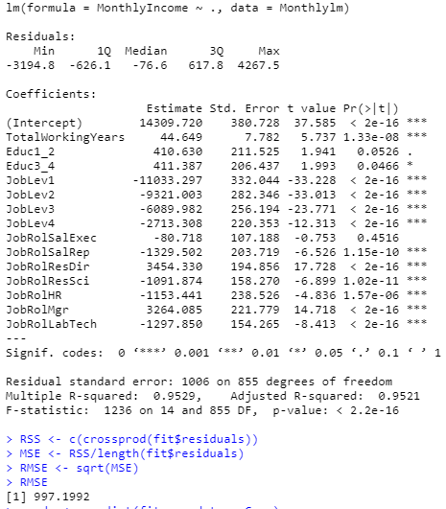
Monthly Salary Estimator
Used Linear Model (lm)
Model:
Monthly Income = $14,309.72 + $44.65*TotalWorkingYears + $410.63*Educ1_2 + $411.39*Educ3_4 - 11033.3*JobLev1 - $9,321*JobLev2 - $6,089.98JobLev3 - $2,713.31*JobLev4 - $80.72*JobRolSalExec - $1,329.5*JobRolSalRep + $3,454.33*JobRolResDir - $1,091.87*JobRolResSci -$1,153.44*JobRolHR + $3,264.08*JobRolMgr - $1,297.85JobRolLabTech
After 100 Iterations in Cross Validation
RMSE
min: 952.95
mean: 992.88
max: 1055.74
R-Squared
min: 0.946
mean: 0.953
max: 0.959

Slide 12
Model Interpretation
Monthly Income = $14,309.72 + $44.65*TotalWorkingYears + $410.63*Educ1_2 + $411.39*Educ3_4 - 11033.3*JobLev1 - $9,321*JobLev2 - $6,089.98JobLev3 - $2,713.31*JobLev4 - $80.72*JobRolSalExec - $1,329.5*JobRolSalRep + $3,454.33*JobRolResDir - $1,091.87*JobRolResSci -$1,153.44*JobRolHR + $3,264.08*JobRolMgr - $1,297.85JobRolLabTech
Reference Categorical Variables – this means with all the other variables we will discuss below are set to 0, we use the intercept by itself plus Working Years * 44.65
Education Level 5
Job Level 5
Job Role of Healthcare Rep and Manufacturing Director
Before we start adding anything to the model in terms of inputs, we start with $14,309.72 (intercept) monthly income
For all other variables held constant, for every company an employee has worked at we multiply that number by $44.65 and add that to the monthly income.
Categorical Variables
If an employee has an Education Level 1 or 2, we add $410.63 to the monthly income
If an employee has an Education Level of 3 or 4, we add $411.39 to the monthly income
If an employee has Job Level 1, we subtract $11,033.30 from the monthly income
If an employee has Job Level 2, we subtract $9,321 from the monthly income
If an employee has Job Level 3, we subtract $6,089.98 from the monthly income
If an employee has Job Level 4, we subtract $2,713.31 from the monthly income
If an employee is a Sales Exec, we subtract $80,72 from the monthly income
If an employee is a Sales Rep, we subtract $1,329.50 from the monthly income
If an employee is a Research Director, we add $3,454.33 to the monthly income
If an employee is a Research Scientist, we subtract $1,091.87 from the monthly income
If an employee is in Human Resources, we subtract $1,153.44 from the monthly income
If an employee is a Manager, we add $3,264.08 to the monthly income
If an employee is a Laboratory Technician, we subtract $1,297.85 from the monthly income

Slide 13
Monthly Income – fun with math!
Model:
Monthly Income = $14,309.72 + $44.65*TotalWorkingYears + $410.63*Educ1_2 + $411.39*Educ3_4 - 11033.3*JobLev1 - $9,321*JobLev2 - $6,089.98JobLev3 - $2,713.31*JobLev4 - $80.72*JobRolSalExec - $1,329.5*JobRolSalRep + $3,454.33*JobRolResDir - $1,091.87*JobRolResSci -$1,153.44*JobRolHR + $3,264.08*JobRolMgr - $1,297.85JobRolLabTech
Job Role: Account Executive
Education Level: 2
Job Level: 2
Years Work Experience: 2
Est Monthly Income = $14,309.72 + $44.65*2yrs + $410.63*1 (education level) - $9,321.00*1 (JobLevel2) - $80.72*1 (Sales Exec)
Est Monthly Income = $14,309.72 + $89.30 - $410.63 - $9,321.00 - $80.72
Est Monthly Income = $14,309.72 - $9,723.05
Est Monthly Income = $4,586.67 gross

Slide 14

Key Takeaways
Overtime, Monthly Income and Stock Options are very important when predicting employee Attrition
71% of your employees don’t earn overtime, but we don’t have any idea of bonuses or other perks
People making OT earn on average $255.98 less per month than people who do not earn OT
Monthly Income is the most statistically significant continuous variable we have in determining Attrition
43.6% of employees do not have stock options and that is a top 3 contributing factor to Attrition
Sales Reps seem to have the lowest average scores in term of categorical variables, but they are also the youngest on average with the least amount of experience
Manager seem to have the most high scores and are the oldest on average with the most experience
Total Working Years, Education, Job Level and Job Role show the most statistical significance for estimating monthly income

Slide 15
Appendix

Slide 16
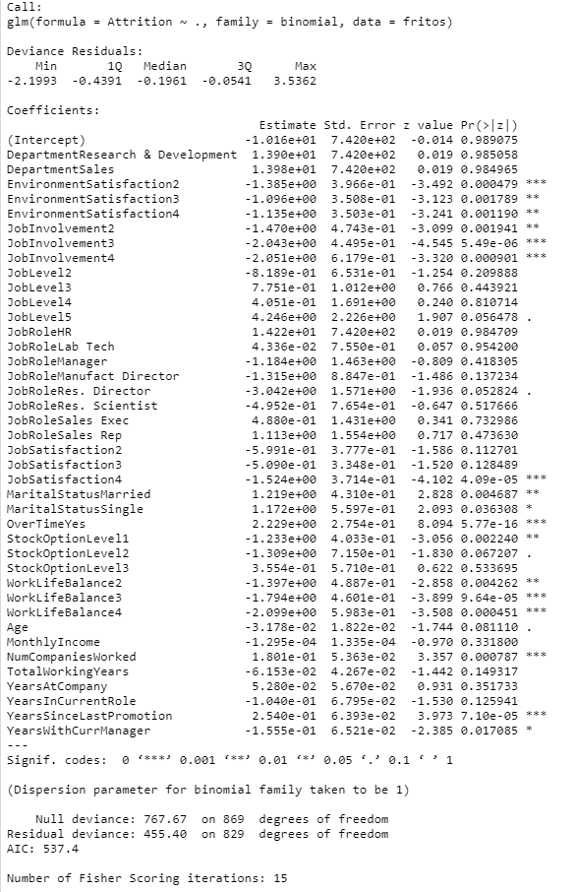
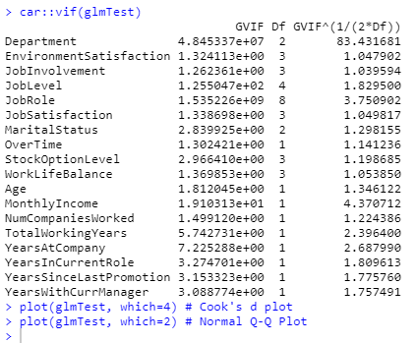
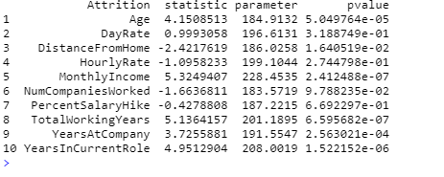
Attrition
Double Checking the Boruta classifier Using GLM
Lots of High P-values, but very low VIFs
After trying to tune it better, found that the algorithm is pretty good at its job
Grouped
Independent

Slide 17
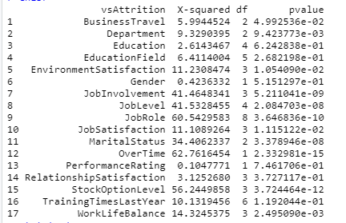
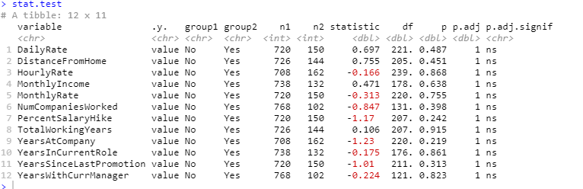
ChiSquared Tests
Independent vs Attrition
Group Test vs Attrition

